Slide 1
Project Title: DIY 8K Inspection of Instrument Air Compressor
Business Case/objectives:
The 8,000hr inspection and servicing of the Okoloma Gas Plant's Atlas Copco Air Compressors is usually carried out by a vendor which costs circa $15,000 to execute for 2 compressors.This Initiative is for the in-house execution of inspection and servicing of K6805 and K6806 using in-house resources and project surplus materials to save the $15,000.
Potential Benefits & Measurement:
circa $ 15,000
Project Scope/Actions :
Assemble all the required parts
obtain asset approval
Execute 8K Inspection
Critical Success Factors:
Okoloma/IMOR PU leadership support
High-level Timeline:
L0-L1: September2018
L2: September2018
L3: September2018
L4: September2018
L5: September2018
Initiative End
Project Sponsor: Onyeka Ikechukwu Implementation Lead: Ogbodu Rume
Project Team:
Tennyson Ukpethu
Edwin Nwougo

Slide 2
Project Title: Resolve Fire water Allen Bradley PLC Communication fault
Business Case/objectives:
The fire water control system (Allen Bradley PLC) has had a long standing fault, hindering remote indication to the DCS and fire water ring main pressure stabilization. The PLC also has a Local display panel (HMI) that displays functional alarms and control system operation status.
Objective:
Restore control room operator remote visual of fire water ring main process automation and functionality
Potential Benefits & Measurement:
circa $ 8000 in FSR fees
Project Scope/Actions :
Conducted DIY based troubleshooting and fault finding
Secured/obtained PLC program from project team
Procured identified defective parts and software
Self taught on the use RS Logix software for troubleshooting and connection to PLC
Replaced defective parts and restored full functionality of the PLC
Critical Success Factors:
Leadership support
C & P for material order
Collaboration within the team
Problem solving skills
High-level Timeline:
L0-L1: September2018
L2: September2018
L3: September2018
L4: September2018
L5: September2018
Initiative End
Project Sponsor: Onyeka Ikechukwu /Bashorun Oladimeji Implementation Lead: Ogbodu Oghenerume
Project Team:
Musa Mohammed A
Obinna Amaizu

Slide 3
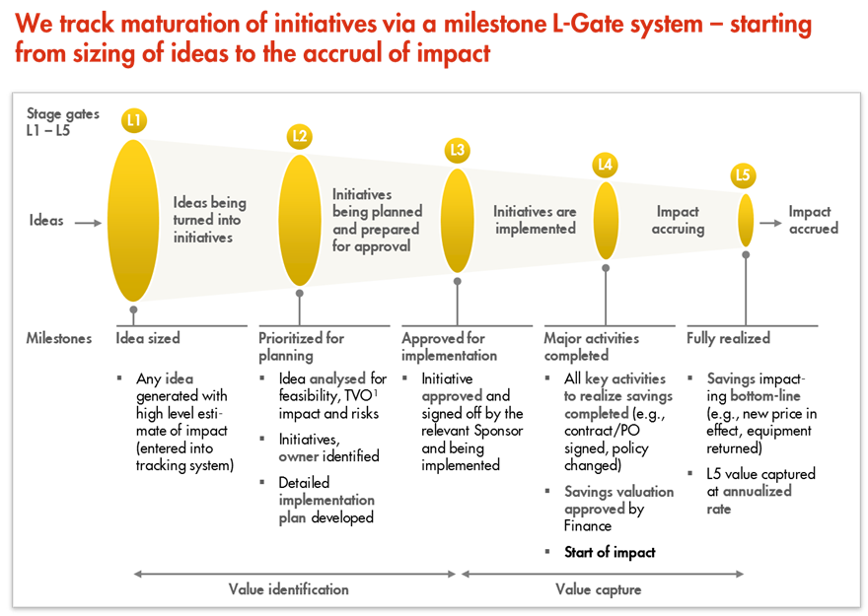
L1 – L5 Gates

